Slide 1
Exit Interview
Alizandro Barraza Mendoza

Slide 2
About Me
September 25th, 1998
Interests
Politics
Whales
Music
Hobby's
Playing guitar
Playing Yu-Gi-Oh
Watching anime

Slide 3
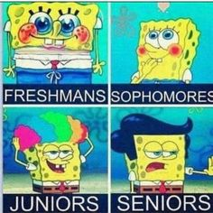
4 Years of High School
Freshman year
Very immature
I had a really bad personality overall
Sophomore year
Maturing a little bit
I became more open minded
Junior year
I was more rebellious
I had gained a new perspective on life
Senior year
Still a little immature
Know how to communicate with people

Slide 4
Job Shadow
Pursuing a career in the arts
Unforgettable experience
On my moms birthday
I job shadowed a college professor
Jim Scully
CSUB

Slide 5
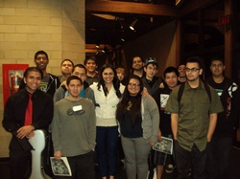
My Pathway
Beginning Guitar
I finished the course in a semester
Intermediate Guitar
Where I began to get sort of good
Advanced Guitar
I’m on my second year of advanced guitar

Slide 6
The Day After Tomorrow
Plan on going to UCSB
Study Computer and Political Science
Become a politician
Plan B
Go to Chico State
Do the same thing
Be a teacher first

Slide 7
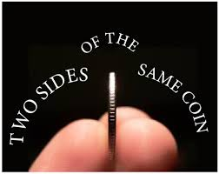
Flip The Coin
Came in a brat
My way or no way
Closed minded
Me before anyone else
Humbled
I’m not so arrogant
I’ve lost a lot of ego
I’m a kinder and more considerate person

Slide 8
Thank You For Your Time

